Slide 1


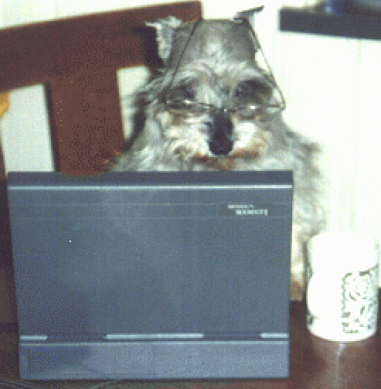
CISC450 Computer Networks
Lesson 5
Packet Switching and Routing
Slides courtesy of
William Stallings (mostly)

Slide 2
Principles
Circuit switching designed for voice
  Resources dedicated to a particular call
  Much of the time a data connection is idle
  Data rate is fixed
    Both ends must operate at the same rate

Slide 3
Packet Data Transfer –
Basic Operation
Data transmitted in small packets
  Typically 1000 octets
  Longer messages split into series of packets
  Each packet contains a portion of user data plus some control info
Control info
  Routing (addressing) info
Packets are received, stored briefly (buffered) and past on to the next node
  Store and forward

Slide 4
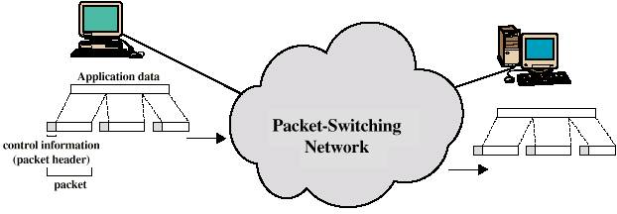
Use of Packets

Slide 5
Advantages
Line efficiency
  Single node to node link can be shared by many packets over time
  Packets queued and transmitted as fast as possible
Data rate conversion
  Each station connects to the local node at its own speed
  Nodes buffer data if required to equalize rates
Packets are accepted even when network is busy
  Delivery may slow down
Priorities can be used

Slide 6
Switching Technique
Station breaks long message into packets
Packets sent one at a time to the network
Packets handled in two ways
  Datagram
  Virtual circuit

Slide 7
Datagram
Each packet treated independently
Packets can take any practical route
Packets may arrive out of order
Packets may go missing
Up to receiver to re-order packets and recover from missing packets

Slide 8
Virtual Circuit
Preplanned route established before any packets sent
Call request and call accept packets establish connection (handshake)
Each packet contains a virtual circuit identifier instead of destination address
No routing decisions required for each packet
Clear request to drop circuit
Not a dedicated path

Slide 9
Virtual Circuits v Datagram
Virtual circuits
  Network can provide sequencing and error control
  Packets are forwarded more quickly
    No routing decisions to make
  Less reliable
    Loss of a node looses all circuits through that node
Datagram
  No call setup phase
    Better if few packets
  More flexible
    Routing can be used to avoid congested parts of the network

Slide 10
Circuit v Packet Switching
Performance
  Propagation delay
  Transmission time
  Node delay
  Creation/Checking of headers

Slide 11
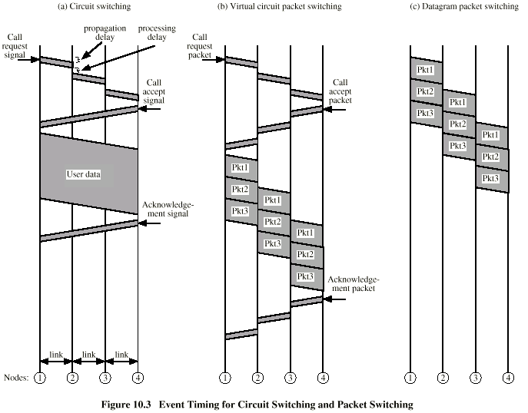
Event Timing

Slide 12
External and Internal Operation
Packet switching - datagrams or virtual circuits
Interface between station and network node
  Connection oriented
    Station requests logical connection (virtual circuit)
    All packets identified as belonging to that connection & sequentially numbered
    Network delivers packets in sequence
    External virtual circuit service
    e.g. X.25
    Different from internal virtual circuit operation
  Connectionless
    Packets handled independently
    External datagram service
    Different from internal datagram operation

Slide 13
Combinations (1)
External virtual circuit, internal virtual circuit
  Dedicated route through network
External virtual circuit, internal datagram
  Network handles each packet separately
  Different packets for the same external virtual circuit may take different internal routes
  Network buffers at destination node for re-ordering

Slide 14
Combinations (2)
External datagram, internal datagram
  Packets treated independently by both network and user
External datagram, internal virtual circuit
  External user does not see any connections
  External user sends one packet at a time
  Network sets up logical connections

Slide 15
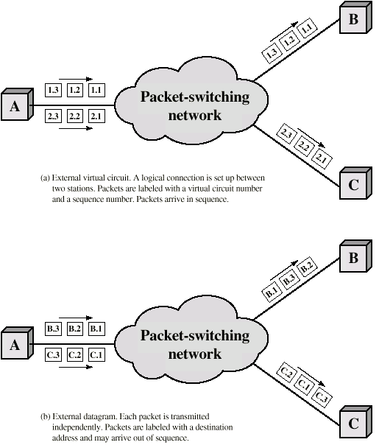
External
Virtual
Circuit and
Datagram
Operation

Slide 16
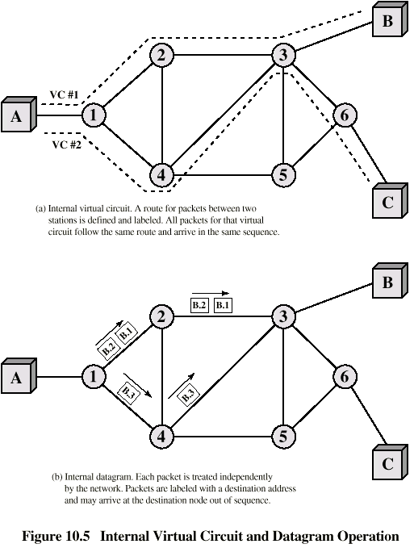
Internal
Virtual
Circuit and
Datagram
Operation

Slide 17
Routing
Complex, crucial aspect of packet switched networks
Characteristics required
  Correctness
  Simplicity
  Robustness
  Stability
  Fairness
  Optimality
  Efficiency

Slide 18
Performance Criteria
Used for selection of route
Minimum hop
Least cost
  See Stallings appendix 10A for routing algorithms

Slide 19
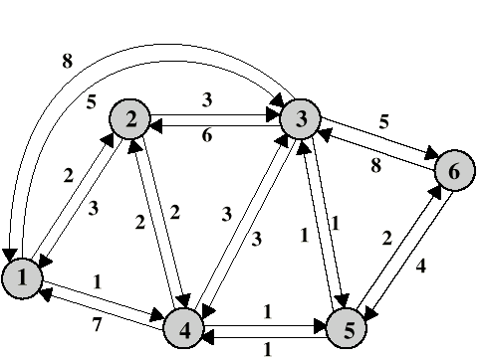
Costing of Routes
Class Question
What do we use to
“cost” a route?
+/-’s?

Slide 20
Decision Time and Place
Time
  Packet or virtual circuit basis
Place
  Distributed
    Made by each node
  Centralized
  Source

Slide 21
Network Information Source and Update Timing
Routing decisions usually based on knowledge of network (not always)
Distributed routing
  Nodes use local knowledge
  May collect info from adjacent nodes
  May collect info from all nodes on a potential route
Central routing
  Collect info from all nodes
Update timing
  When is network info held by nodes updated
  Fixed - never updated
  Adaptive - regular updates

Slide 22
Routing Strategies
Fixed
Flooding
Random
Adaptive

Slide 23
Fixed Routing
Single permanent route for each source to destination pair
Determine routes using a least cost algorithm (appendix 10A)
Route fixed, at least until a change in network topology

Slide 24
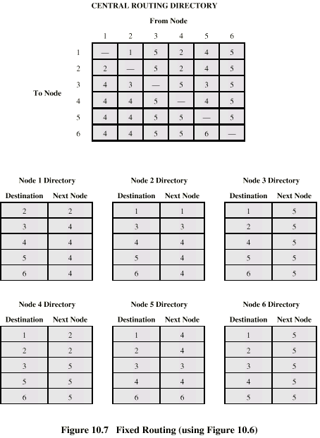
Fixed Routing
Tables

Slide 25
Flooding
No network info required
Packet sent by node to every neighbor
Incoming packets retransmitted on every link except incoming link
Eventually a number of copies will arrive at destination
Each packet is uniquely numbered so duplicates can be discarded
Nodes can remember packets already forwarded to keep network load in bounds
Can include a hop count in packets

Slide 26
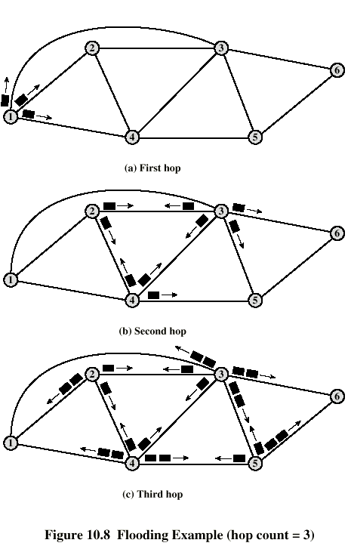
Flooding
Example

Slide 27
Properties of Flooding
All possible routes are tried
  Very robust
At least one packet will have taken minimum hop count route
  Can be used to set up virtual circuit
All nodes are visited
  Useful to distribute information (e.g. routing)

Slide 28
Random Routing
Node selects one outgoing path for retransmission of incoming packet
Selection can be random or round robin
Can select outgoing path based on probability calculation
No network info needed
Route is typically not least cost nor minimum hop

Slide 29
Adaptive Routing
Used by almost all packet switching networks
Routing decisions change as conditions on the network change
  Failure
  Congestion
Requires info about network
Decisions more complex
Tradeoff between quality of network info and overhead
Reacting too quickly can cause oscillation
Too slowly to be relevant

Slide 30
Adaptive Routing - Advantages
Improved performance
Aid congestion control (See chapter 12)
Complex system
  May not realize theoretical benefits

Slide 31
Classification
Based on information sources
  Local (isolated)
    Route to outgoing link with shortest queue
    Can include bias for each destination
    Rarely used - do not make use of easily available info
  Adjacent nodes
  All nodes

Slide 32
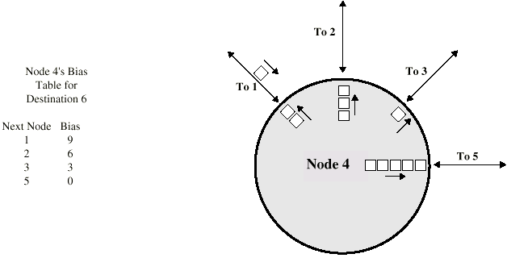
Isolated Adaptive Routing

Slide 33
ARPANET Routing Strategies(1)
First Generation
  1969
  Distributed adaptive
  Estimated delay as performance criterion
  Bellman-Ford algorithm (appendix 10a)
  Node exchanges delay vector with neighbors
  Update routing table based on incoming info
  Doesn't consider line speed, just queue length
  Queue length not a good measurement of delay
  Responds slowly to congestion

Slide 34
ARPANET Routing Strategies(2)
Second Generation
  1979 (DLM!)
  Uses delay as performance criterion
  Delay measured directly
  Uses Dijkstra’s algorithm (appendix 10a)
  Good under light and medium loads
  Under heavy loads, little correlation between reported delays and those experienced

Slide 35
ARPANET Routing Strategies(3)
Third Generation
  1987
  Link cost calculations changed
  Measure average delay over last 10 seconds
  Normalize based on current value and previous results

Slide 36
X.25
1976
Interface between host and packet switched network
Almost universal on packet switched networks and packet switching in ISDN
Defines three layers
  Physical
  Link
  Packet

Slide 37
X.25 - Physical
Interface between attached station and link to node
Data terminal equipment DTE (user equipment)
Data circuit terminating equipment DCE (node)
Uses physical layer specification X.21
Reliable transfer across physical link
Sequence of frames

Slide 38
X.25 - Link
Link Access Protocol Balanced (LAPB)
  Subset of HDLC
  see chapter 7

Slide 39
X.25 - Packet
External virtual circuits
Logical connections (virtual circuits) between subscribers

Slide 40
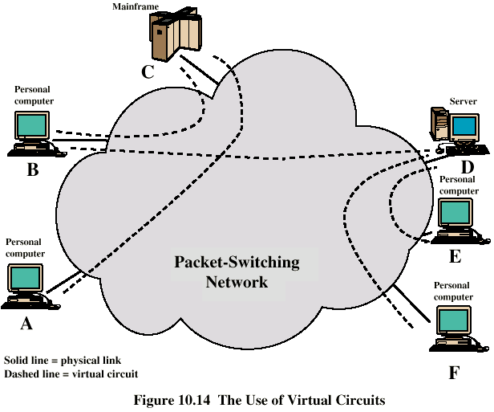
X.25 Use of Virtual Circuits

Slide 41
Virtual Circuit Service
Virtual Call
  Dynamically established
Permanent virtual circuit
  Fixed network assigned virtual circuit

Slide 42
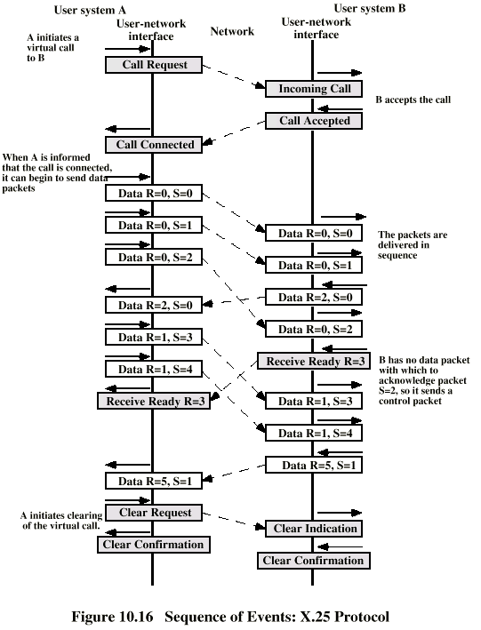
Virtual Call

Slide 43
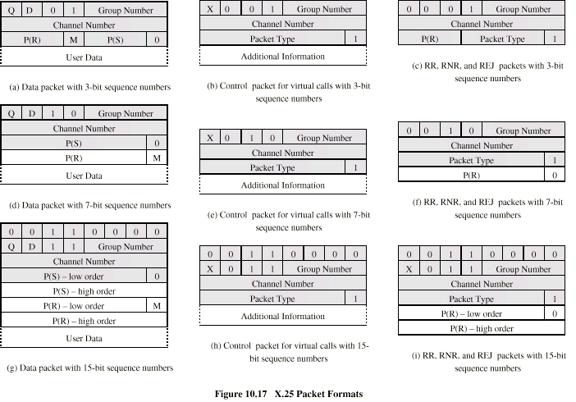
Packet Formats

Slide 44
Multiplexing
DTE can establish 4095 simultaneous virtual circuits with other DTEs over a single DTC-DCE link
Packets contain 12 bit virtual circuit number

Slide 45
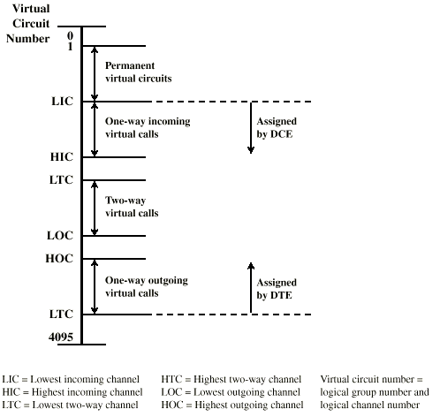
Virtual Circuit Numbering

Slide 46
Packet Sequences
Complete packet sequences
Allows longer blocks of data across network with smaller packet size without loss of block integrity
A packets
  M bit 1, D bit 0
B packets
  The rest
Zero or more A followed by B

Slide 47
Reset and Restart
Reset
  Reinitialize virtual circuit
  Sequence numbers set to zero
  Packets in transit lost
  Up to higher level protocol to recover lost packets
  Triggered by loss of packet, sequence number error, congestion, loss of network internal virtual circuit
Restart
  Equivalent to a clear request on all virtual circuits
  E.g. temporary loss of network access

Slide 48
What Is Congestion?
Congestion occurs when the number of packets being transmitted through the network approaches the packet handling capacity of the network
Congestion control aims to keep number of packets below level at which performance falls off dramatically
Data network is a network of queues
Generally 80% utilization is critical (but not always!)
Finite queues mean data may be lost

Slide 49
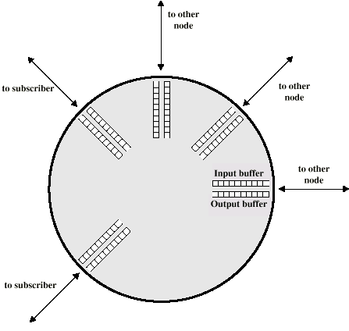
Queues at a Node

Slide 50
Effects of Congestion
Packets arriving are stored at input buffers
Routing decision made
Packet moves to output buffer
Packets queued for output transmitted as fast as possible
  Statistical time division multiplexing
If packets arrive to fast to be routed, or to be output, buffers will fill
Can discard packets
Can use flow control
  Can propagate congestion through network

Slide 51
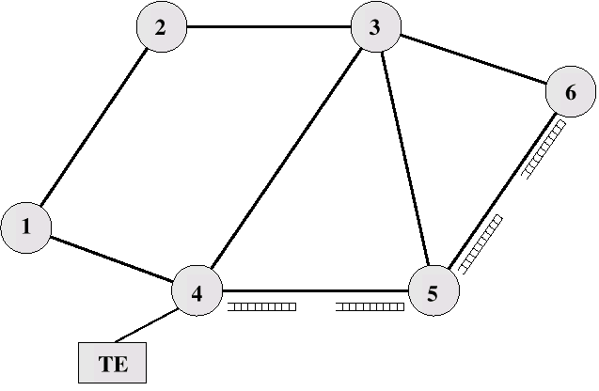
Interaction of Queues

Slide 52
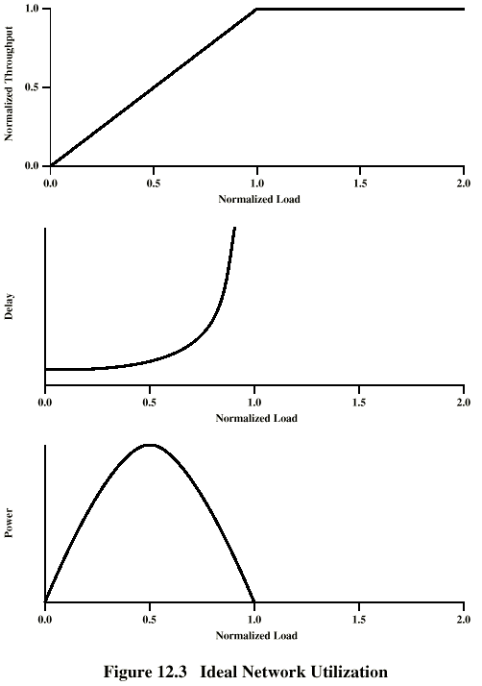
Ideal
Performance

Slide 53
Practical Performance
Ideal assumes infinite buffers and no overhead
Buffers are finite
Overheads occur in exchanging congestion control messages

Slide 54
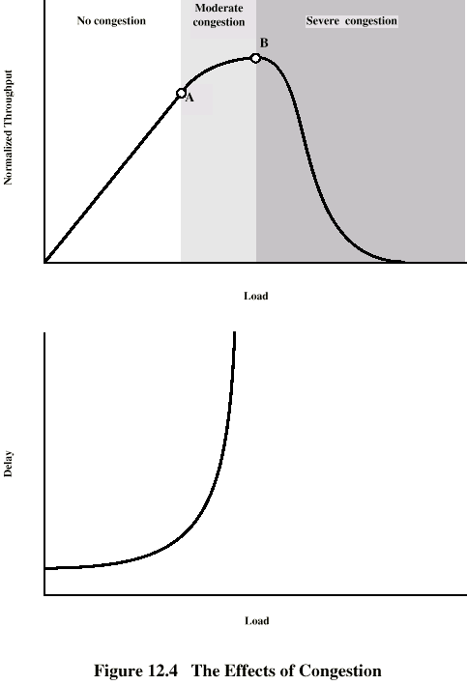
Effects of
Congestion -
No Control

Slide 55
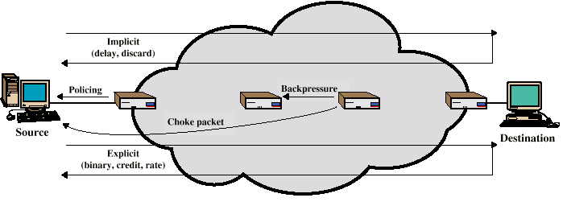
Mechanisms for
Congestion Control

Slide 56
Backpressure
If node becomes congested it can slow down or halt flow of packets from other nodes
May mean that other nodes have to apply control on incoming packet rates
Propagates back to source
Can restrict to logical connections generating most traffic
Used in connection oriented that allow hop by hop congestion control (e.g. X.25)
Not used in ATM nor frame relay
Only recently developed for IP

Slide 57
Choke Packet
Control packet
  Generated at congested node
  Sent to source node
  e.g. ICMP source quench
    From router or destination
    Source cuts back until no more source quench message
    Sent for every discarded packet, or anticipated
Rather crude mechanism

Slide 58
Implicit Congestion Signaling
Transmission delay may increase with congestion
Packet may be discarded
Source can detect these as implicit indications of congestion
Useful on connectionless (datagram) networks
  e.g. IP based
    (TCP includes congestion and flow control - see chapter 17)
Used in frame relay LAPF

Slide 59
Explicit Congestion Signaling
Network alerts end systems of increasing congestion
End systems take steps to reduce offered load
Backwards
  Congestion avoidance in opposite direction to packet required
Forwards
  Congestion avoidance in same direction as packet required

Slide 60
Categories of Explicit Signaling
Binary
  A bit set in a packet indicates congestion
Credit based
  Indicates how many packets source may send
  Common for end to end flow control
Rate based
  Supply explicit data rate limit
  e.g. ATM

Slide 61
Traffic Management
Fairness
Quality of service
  May want different treatment for different connections
Reservations
  e.g. ATM
  Traffic contract between user and network

Slide 62
Congestion Control in Packet Switched Networks
Send control packet to some or all source nodes
  Requires additional traffic during congestion
Rely on routing information
  May react too quickly
End to end probe packets
  Adds to overhead
Add congestion info to packets as they cross nodes
  Either backwards or forwards

Slide 63
Frame Relay
Congestion Control
Minimize discards
Miantain agreed QoS
Minimize probability of one end user monoply
Simple to implement
  Little overhead on network or user
Create minimal additional traffic
Distribute resources fairly
Limit spread of congestion
Operate effectively regardless of traffic flow
Minimum impact on other systems
Minimize variance in QoS

Slide 64
Techniques
Discard strategy
Congestion avoidance
Explicit signaling
Congestion recovery
Implicit signaling mechanism

Slide 65
Traffic Rate Management
Must discard frames to cope with congestion
  Arbitrarily, no regard for source
  No reward for restraint so end systems transmit as fast as possible
  Committed information rate (CIR)
    Data in excess of this liable to discard
    Not guaranteed
    Aggregate CIR should not exceed physical data rate
Committed burst size
Excess burst size

Slide 66
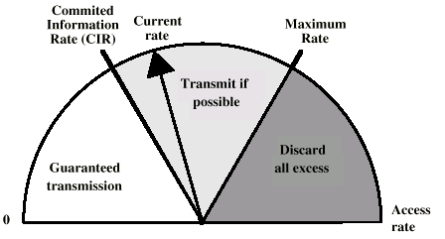
Operation of CIR

Slide 67
Explicit Signaling
Network alerts end systems of growing congestion
Backward explicit congestion notification
Forward explicit congestion notification
Frame handler monitors its queues
May notify some or all logical connections
User response
  Reduce rate

